Slide 1
The status of EU law in the UK after Brexit: introduction
David Anderson
Lord Anderson KBE QC
Brick Court Chambers @bricksilk
ALBA, 2 March 2020

Slide 2
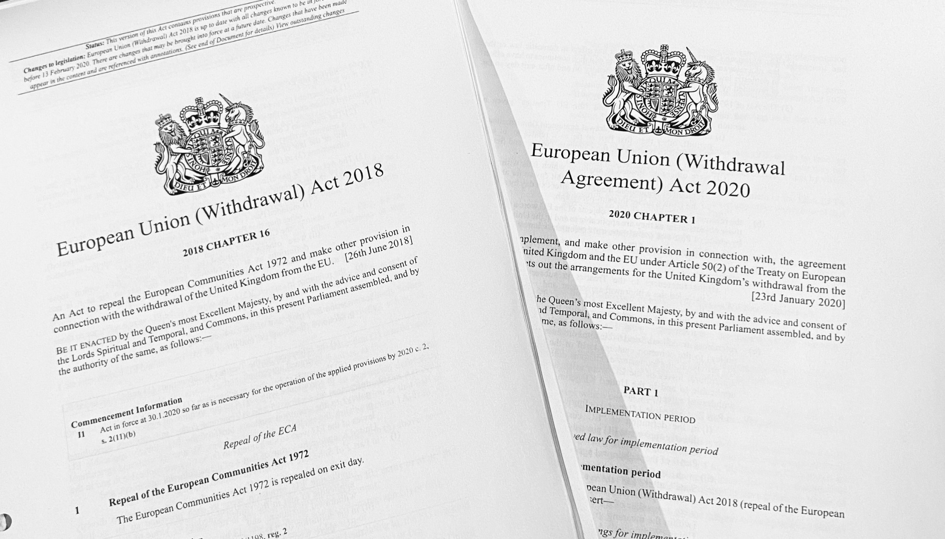
EU(W)A and EU(WA)A
Notes:
Two Acts with confusingly similar titles.
EUWA in its original form was enacted, before there was any WA. It was, effectively, the Act for a no-deal Brexit.
EUWAGA gives effect to the WA in domestic law, partly by amending EUWA and partly by its own self-standing provisions.
So to see how the WA is implemented, you have to look at (1) EUWA as amended by EUWAGA (2) the free-standing provisions of EUWAGA.

Slide 3
A Tale of Two WABs
OCTOBER 2019
HoC power over:
extending transition
starting negotiations
negotiating mandate
approval of FRT
Workers’ rights
DECEMBER 2019
s33: No extension
S37: Child asylum
s26: Directing courts
s29: HoL EU Cttee
Notes:
It is well known that the WA itself came in two forms, the Theresa May version of November 2018 and the Boris Johnson version of October 2019. The chief difference related to the NI Protocol.
For reasons unrelated to that, the WAB was also presented twice, before and after the GE. An object-lesson in power.
In order to sell the first WAB to a Parliament where there was no automatic majority, it was thought necessary to give the HoC in particular some pretty strong powers: (1) veto over extension to transition 2) veto over start of future relationship negotiation (3)approval role in relation to negotiating mandate (4) enhanced P approval process for any future relationship treaty … and additional procedural protections for workers’ rights that are currently part of EU law but which could otherwise have been repealed or modified after the transition period.
Each of those clauses was simply removed. And inserted were: (1) NO extension (2) s26 (3) removal of the legal obligation re child asylum. Oddly, a measure of additional parliamentary scrutiny came in by s29, which gives the HL EU Cttee a scrutiny function in relation to developments in EU law “of vital national interest” during the implementation period. (Also good, for those who think there is value in P scrutiny: the perpetuation of Hilary Benn’s Exiting the EU Committee)

Slide 4
TRANSITION PERIOD (2020) Withdrawal Agreement (WA)
Union law applies (Treaties,CFR, GPL, EU acts) to the UK (Art 2)
EU principles of interpretation apply, inc. references to CJEU (Arts 127, 86)
EU agencies retain supervisory and enforcement powers (Art 131)
Direct effect and supremacy apply (Art 4)

Slide 5
TRANSITION PERIOD (2020) EU(W)A 2018 as amended
ECA 1972 repealed on exit day (31/01/20: s1) but “saved” for transition period: (s1A)
EU law as at exit day applies in UK (s1A(3))
“EU-derived domestic legislation” as at exit day remains in force, with glosses (s1B)

Slide 6
AFTER “IPC DAY” (2021-) Retained EU law (REUL)
EU-derived domestic legislation (EU(W)A s2)
Direct EU law (s3): Regulations, Decisions &c applicable to the UK (but not CFR)
Directly effective rights &c (s4) under ECA: Treaties, recognised directives and GPLs
No right of action for failure to comply with GPL, or for Francovich damages (Sch 1 ps 3,4)

Slide 7
AFTER “IPC DAY” (2021-) Interpretation of REUL
REUL has supremacy over pre-IPC domestic law, but not post-IPC law (s5)
Retained case law / GPLs: binding (s6(3))
Post-IPC CJEU rulings: may have regard (s6(2))
No more references to CJEU (s6(1))
Supreme Court is not bound by REUL (s6(4)): may depart as if from its own decisions

Slide 8
AFTER “IPC DAY” (2021-) Implementation of WA
Rights arising under WA have direct effect and supremacy under EU(W)A s7A:
Citizens’ rights (EU(WA)A 2020 Part 3)
Financial provisions (EU(WA)A s20)
Northern Ireland Protocol (EU(W)(A) s8C)
Similar conduit under EU(W)A s7B for rights arising under
EEA EFTA separation agreement
Swiss citizens’ rights agreement

Slide 9
DELEGATED POWERS
To deal with “deficiencies arising from withdrawal”: EU(W)A s8 as amended
In connection with the IP (s8A), separation provisions (s8B), NI Protocol (s8C: “Henry VIII on steroids”, though limited by WA)
To tell courts the extent to which they are not bound by REUL (s6(5)A-D: pre-IPC)

Slide 10
The status of EU law in the UK after Brexit: introduction
David Anderson
Lord Anderson KBE QC
Brick Court Chambers @bricksilk
ALBA, 2 March 2020

